Slide 1

BigTable: A Distributed Storage System for Structured Data
Course Information
DCS HPC - CSE449
Summer 2022
Group Information
Tanvir Rahman - 19101268
Group - 5

Slide 2
Instead of fighting other woman for a seat at the table,
DEMAND A BIGGER TABLE

Slide 3
What is BigTable?
A NoSQL database services for large analytical and operational workloads
Designed to scale large size data
Fault-tolerant, flexible and high performance solution
Self-managed database system
Used in Web Indexing, Personalized Search, Google Map-Earth-Analytics
Related Works
Apache Cassandra
Apache HBase
Apache Ignite
Amazon SimpleDB
Couchbase Server

Slide 4




MOTIVATION
Requirement
Performance
Cost
Need of storage expansion
Low level storage optimization
Wide scalability and applicability
High performance and availability
Cost of commercial databases can be reduced
Internal system building cost can be decreased

Slide 5
DATA MODEL
Row and Column keys known as Tablets and Column Families
Uses load balancing and units of distribution for Tablets
Timestamps are 64-bit integers
Does not support relational data model completely
Allows for dynamic control over data layout and format
Allows clients to manage locality of their data through a particular schema

Slide 6

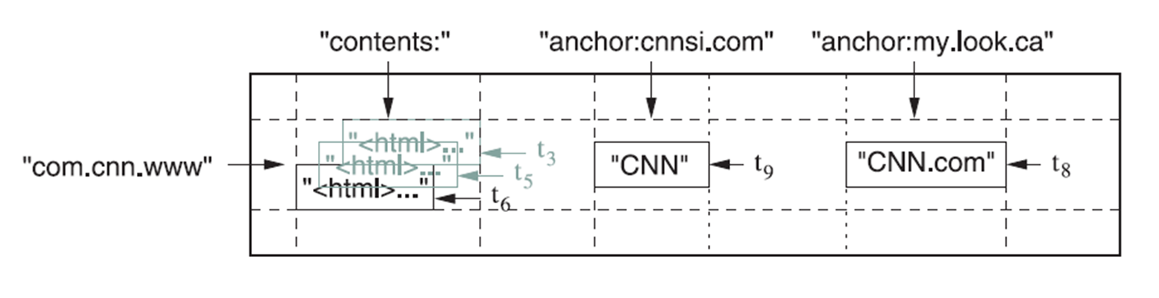
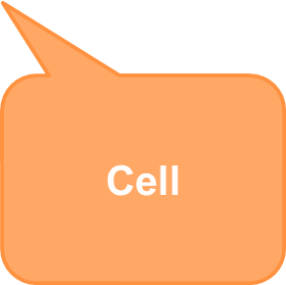
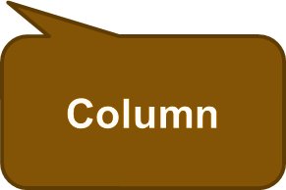
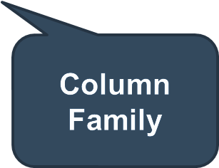
DATA MODEL (cont.)

Slide 7
BUILDING BLOCKS
Name | Services | Processes
Google File System (GFS) | Raw Storage | Conserves persistent state
Lock Service | Manages distributed locks | Does master selection and bootstrapping for locations
MapReduce | Easy processing for large-scale data | Uses frequently to read/write BigTable data
Scheduler | Job scheduling for machines | Schedules BigTable serving jobs

Slide 8
GOOGLE FILE SYSTEM
Masters
Servers
GFS Master
Client
Replicas
GFS Master
Client
C0
C1
C1
C0
C5
Chunkserver 1
Chunkserver 2
Chunkserver N
C5
C2
C5
C3
C2

Slide 9
IMPLEMENTATION
Consists of three major parts
metadata ops
BigTable Client
Client Library
Master Server
Tablet Servers
BigTable Client Library
BigTable Master
performs metadata operations & load balancing
read/write
open()
BigTable Tablet Server
BigTable Tablet Server
BigTable Tablet Server
serves data
serves data
serves data
Cluster Scheduling System
GFS
Lock Service
Monitors and handles failover
holds tablet data, logs
holds metadata, handles master-election

Slide 10
CLIENT FINDS TABLET
UserTable 1
METADATA TABLETS
Root Tablet
Chubby File
UserTable N

Slide 11
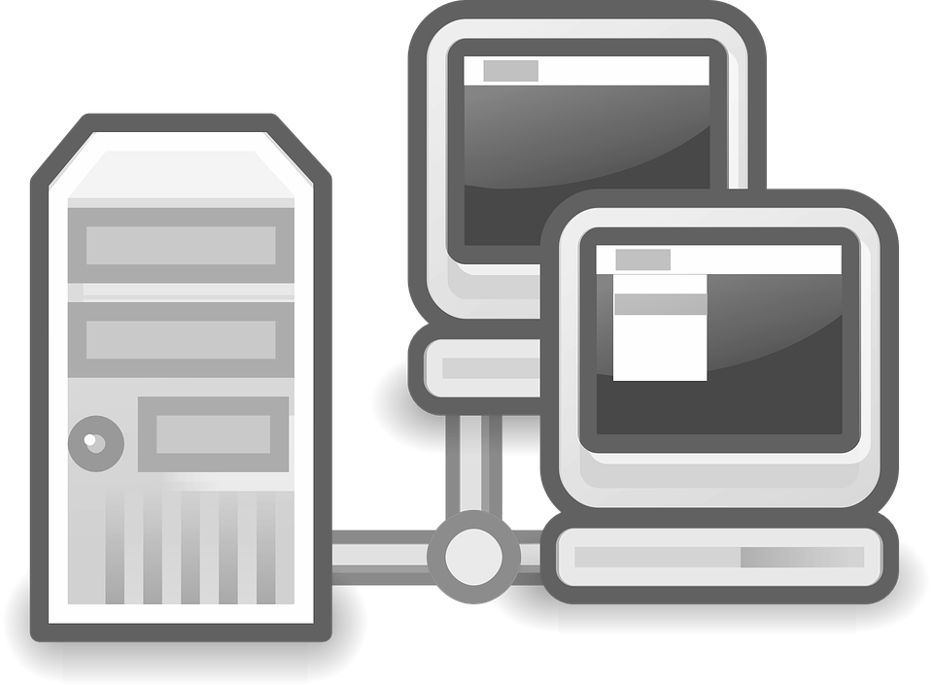
TABLET SERVER
Manages a set of tablets
Handles read and write operations
Splits tablets if grown too large
Aims for ~100MB to 200MB of data per tablet
Responsible for ~100 tablets
Fine-grainer load balancing

Slide 12
TABLET SERVING
Memtable
Read Operations
Memory
GFS
Commit Log
SSTable Files
Write Operations

Slide 13
GOOGLE CLUSTER
Cluster Scheduling System
Lock Service
GFS
Machine 1
Machine 2
Machine N
User App 1
BigTable Server
BigTable Server
BigTable Master
User App 1
User App 2
Scheduler Slave
GFS Chunkserver
Scheduler Slave
GFS Chunkserver
Scheduler Slave
GFS Chunkserver
Linux
Linux
Linux

Slide 14
CLIENT API
Function for tables, columns families to create or delete
Function for changing cluster, table, column family metadata
Supports for single row transactions
Allows cells to be used as integer counters
Clients can execute scripts in server side

Slide 15
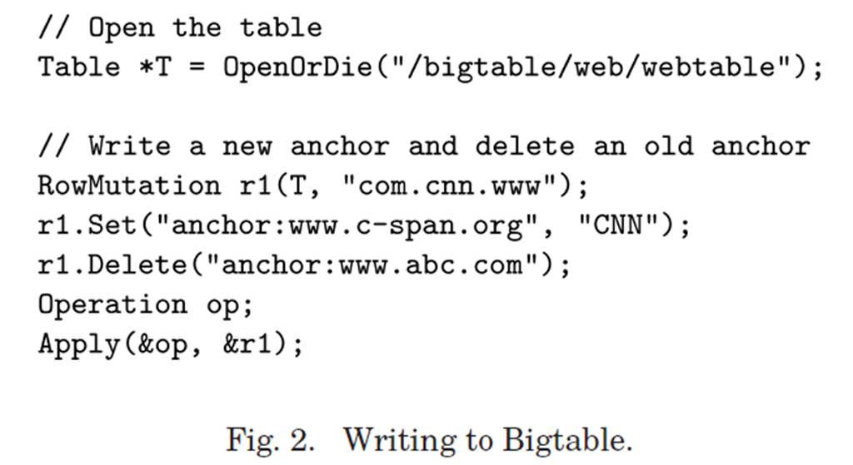
UPDATE ROW
Mutating the row
Storing new item under column key
Deleting an item under column key
Atomic the mutation

Slide 16
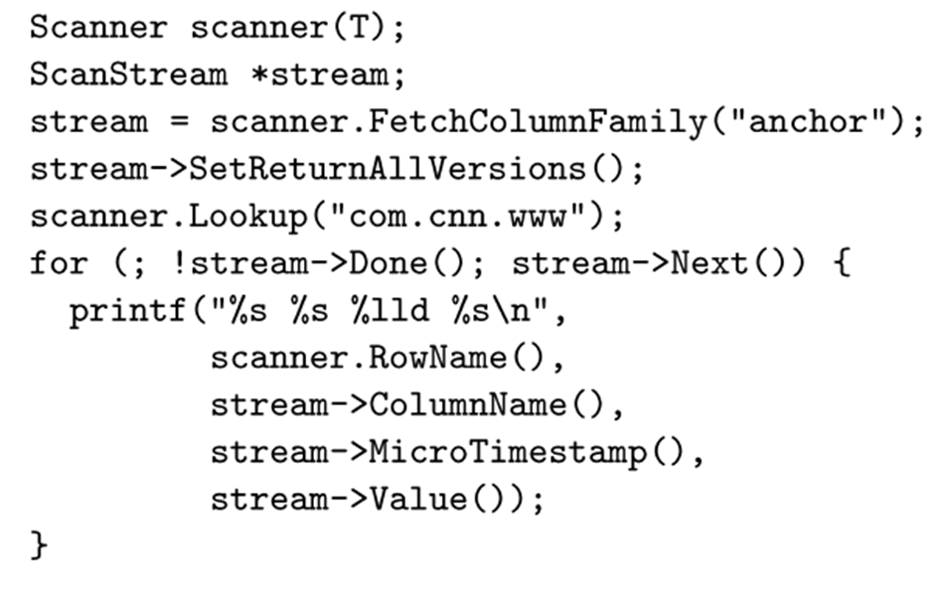
ITERATE TABLE
Access column family
Specify return version
Specify row key
Iterate over rows

Slide 17
COMPACTIONS
Tablet state is represented as a collection of SSTable files that have been compressed and are immutable.
Minor Compaction
Memtables freeze, new ones get created, and writes content to SSTables that are kept in GFS whenever the in-memory state exceeds limit.
Major Compaction
Occasionally consolidates associated SSTables into a new version of SSTable on GFS. And, from the deletions process storage gets recovered.
*GFS = Google File System

Slide 18
COMPACTIONS (cont.)
Limit reached
Memtable
Memtable
Memory
Memory
GFS
GFS
Commit Log
Commit Log
SSTable
SSTable
Write Operations
Major Compaction
Write Operations

Slide 19
REFINEMENTS
Group multiple column families together
Compress locality groups using Bentley and McIlroy scheme
Bloom filters allows to ask existence of data into a specific row/column pair
Caching for read performance
Scan Cache
A higher level cache that stores key-value pairs which are returned by the SSTable interface to the tablet server code
Block Cache
A lower level cache that stores SSTable blocks which are read from GFS.

Slide 20
SINGLE TABLET SERVER
Number of 1000-byte values are read/write per second.
Experiment | Table Server Count
 | 1 | 50 | 250 | 500
Random reads | 1212 | 593 | 479 | 241
Random reads (mem) | 10811 | 8511 | 8000 | 6250
Random writes | 8850 | 3745 | 3425 | 2000
Sequential reads | 4425 | 2463 | 2625 | 2469
Sequential writes | 8547 | 3623 | 2451 | 1905
Scans | 15385 | 10526 | 9524 | 7843

Slide 21
FUTURE PLANS
Multi row transaction support
Performance enhancing for large cells
Resource fairness, performance, isolation, prioritization across different clients
More expressive data manipulation
Support advanced indexing like secondary indices

Slide 22
CONCLUSIONS
Provides high performance storage system
Data model applicable to broad range of clients
Advantages of building own storage system
Able to handle such a wide array of requirements and workloads

Slide 23
REFERENCES
Chang F., Dean J., Ghemawat S., Hsieh W.C., Deborah A. Wallach, Burrows M., Chandra T., Fikes A., & Gruber R.E. (2006). Bigtable: A Distributed Storage System for Structured Data. In 7th USENIX Symposium on Operating Systems Design and Implementation (OSDI) (pp. 205–218).
Joen K. (2012). Bigtable: A Distributed Storage System for Structured Data. Web-scale Data Management. https://slideplayer.com/slide/2749665.
Pirzadeh P., Ayyalasomayajula V. (2017). Bigtable: A Distributed Storage System for Structured Data. https://slidetodoc.com/bigtable-a-distributed-storage-system-for-structured-data-3.
Habibi B., Habibi S., Forouzandeh S. (2016). Bigtable: A Distributed Storage System for Structured Data. https://slideplayer.com/slide/7934078.
Fawad A. (2015). BigTable and Google File System (GFS). https://slideplayer.com/slide/6230378.

Slide 24
THANK YOU

